Slide 1
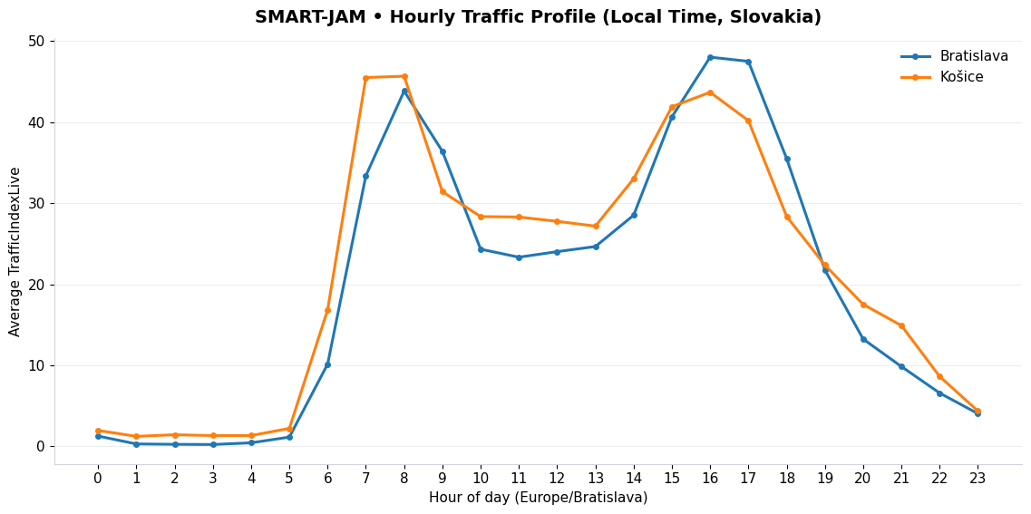

Model Data Visualisation
Team SMART-JAM

Slide 2
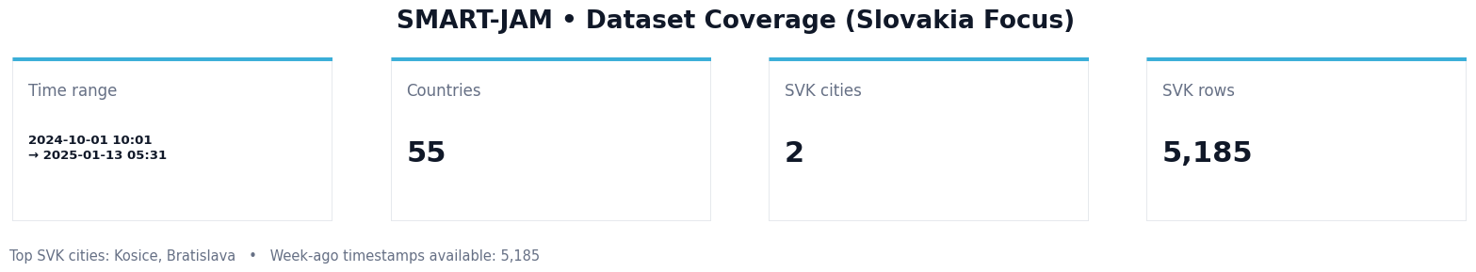
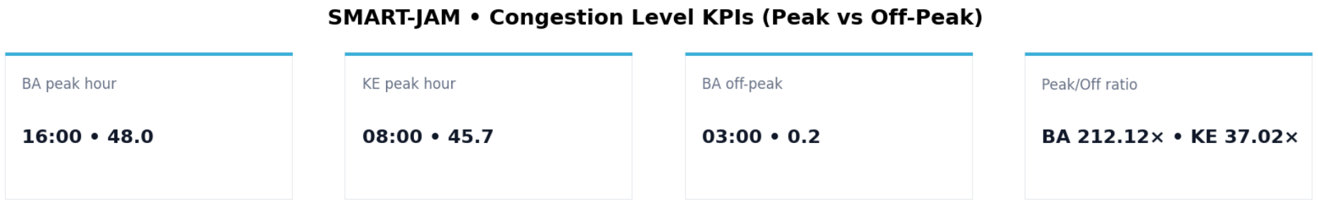
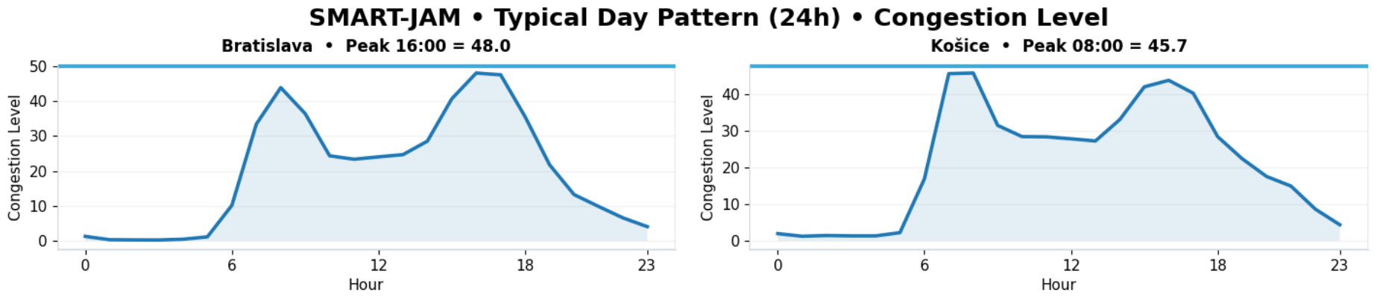
Using most up-to date data we plan to determine most efficient routes

Slide 3
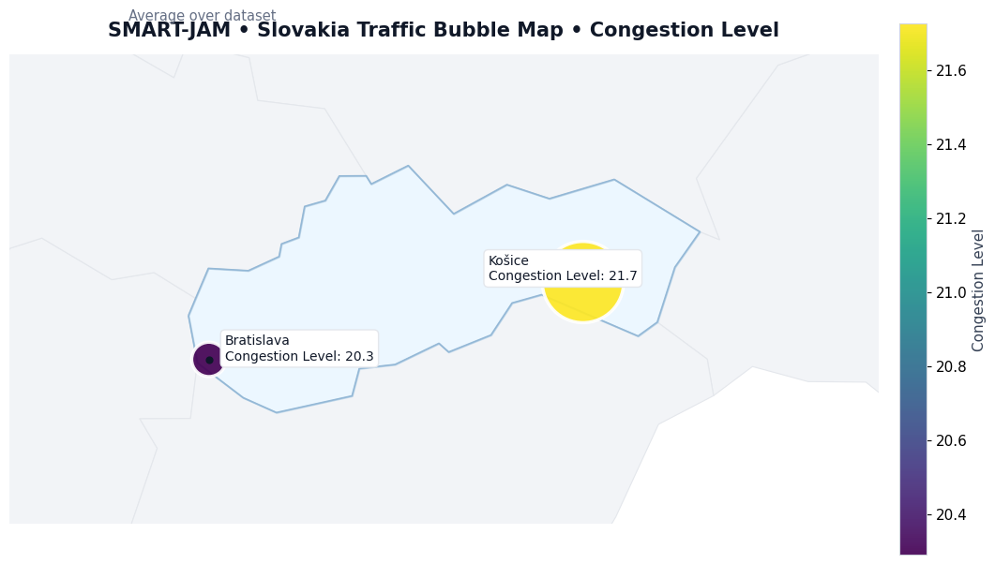
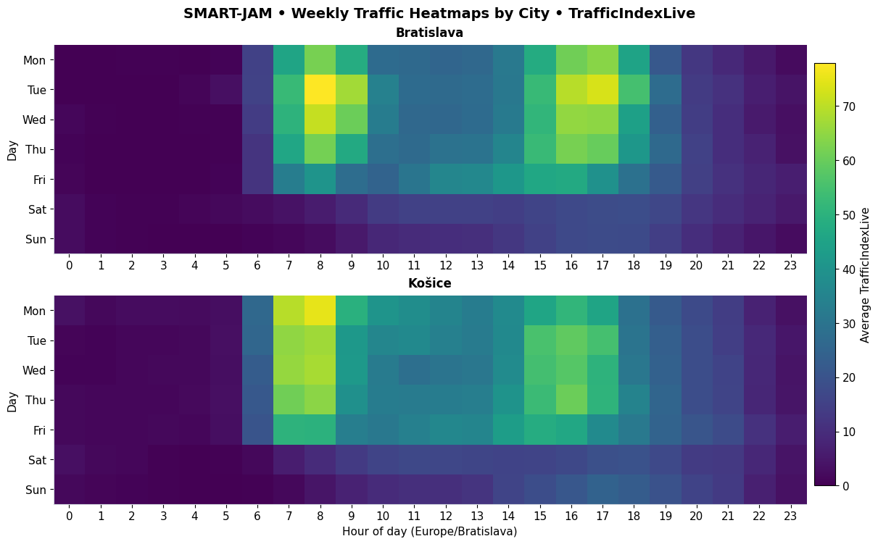
Congestion levels
Congestion in Košice and Bratislava
(Congestion level of 20 = trips take about 20% longer as opposed to free-flow traffic trips)

Slide 4
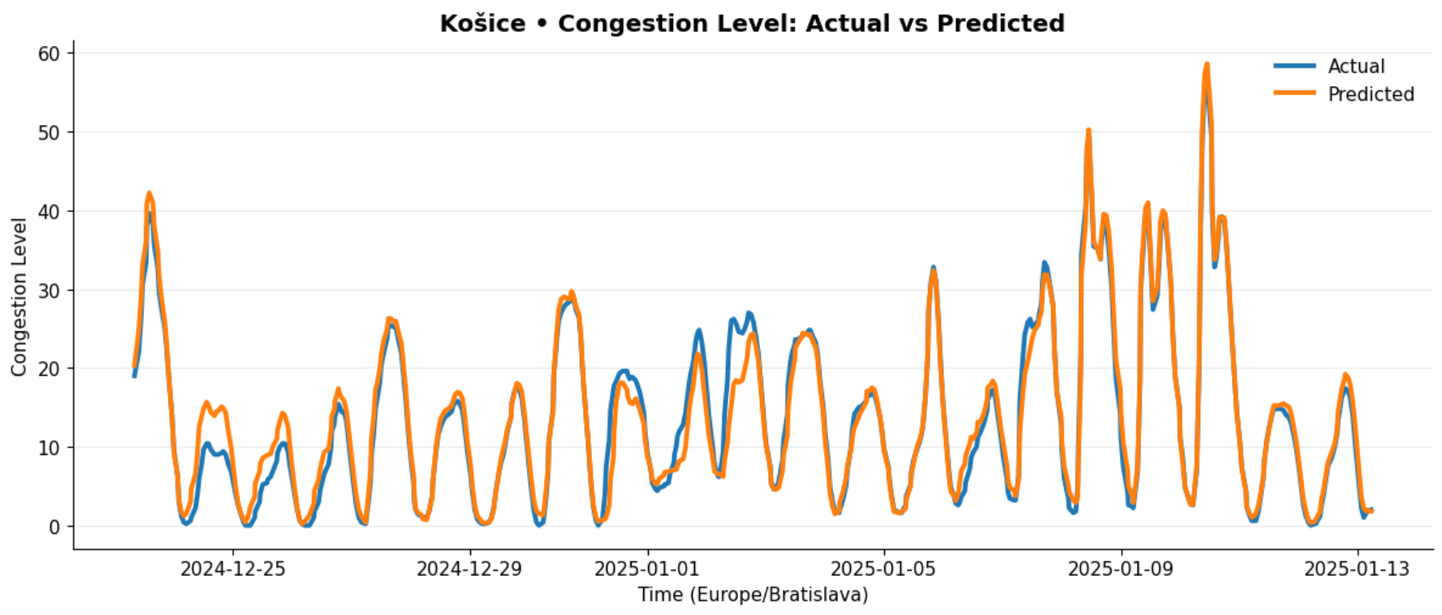
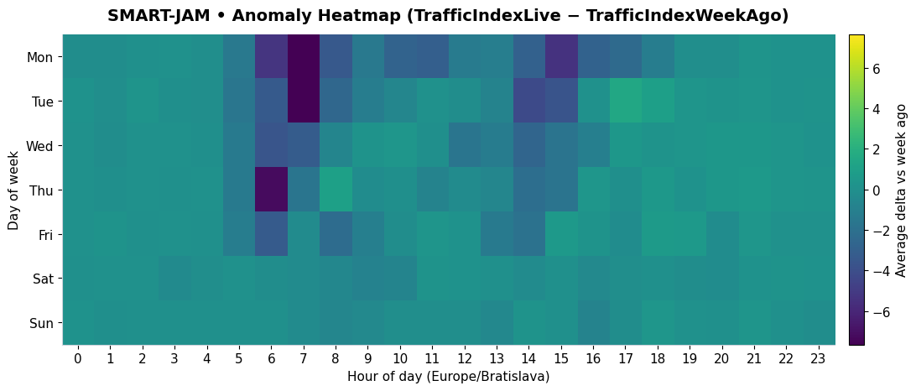
From data to predictions
Our goal – use real time data to make hasty predictions and satisfy users

Slide 5
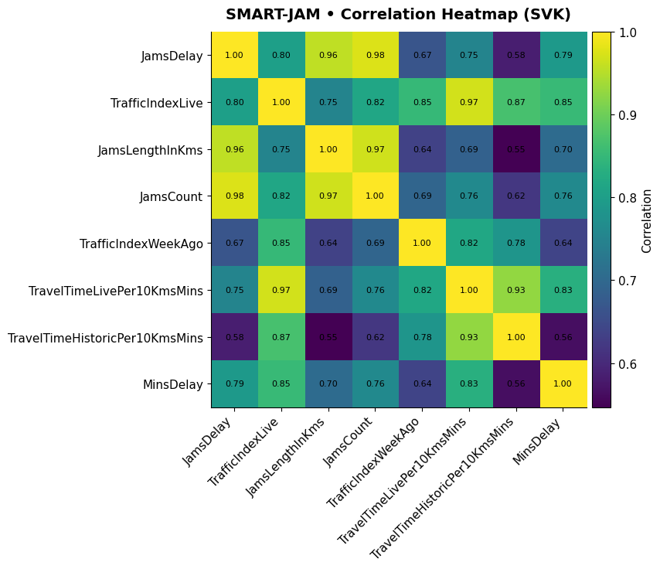

Slide 6
Thank you for your attention

